Slide 1
CEIS114-Introduction to Digital Devices
Where you will explore concepts of electronics, particularly digital electronics.

Slide 2
IoT devices use sensors, controllers, and actuators and are connected via the Internet. They are used in various industries and households. Today's computing power in smartphones far exceeds that of the 1960s computers. These devices heavily utilize digital technology and work with binary language. Implementing state machines in IoT devices provides efficiency and compactness. This enhances device
Introduction

Slide 3
Project Plan for IoT Traffic Controller

Slide 4
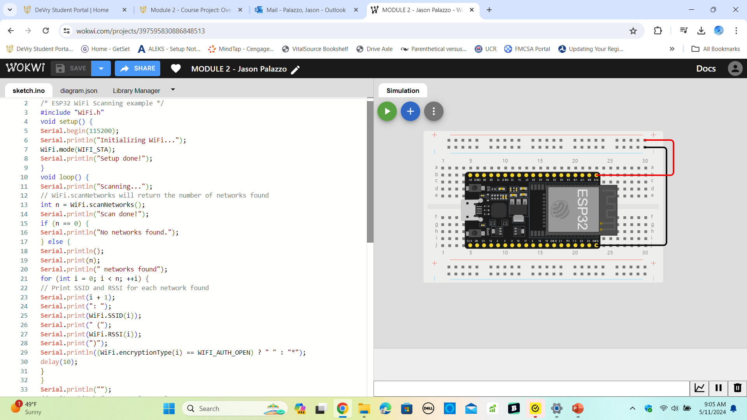
ESP32 Microcontroller Mounted and powered on

Slide 5
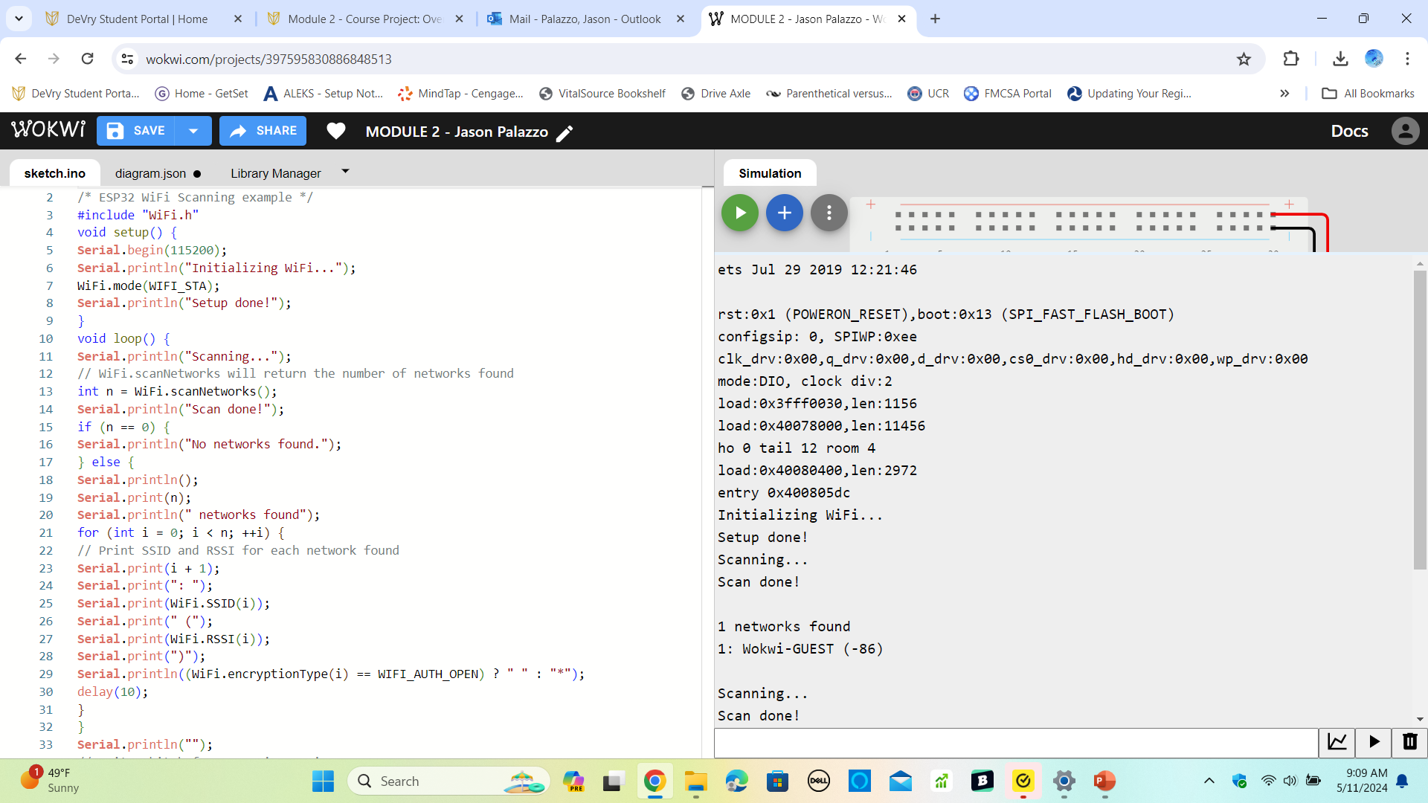
Serial Monitor showing the available networks

Slide 6
Creating the Traffic Controller

Slide 7
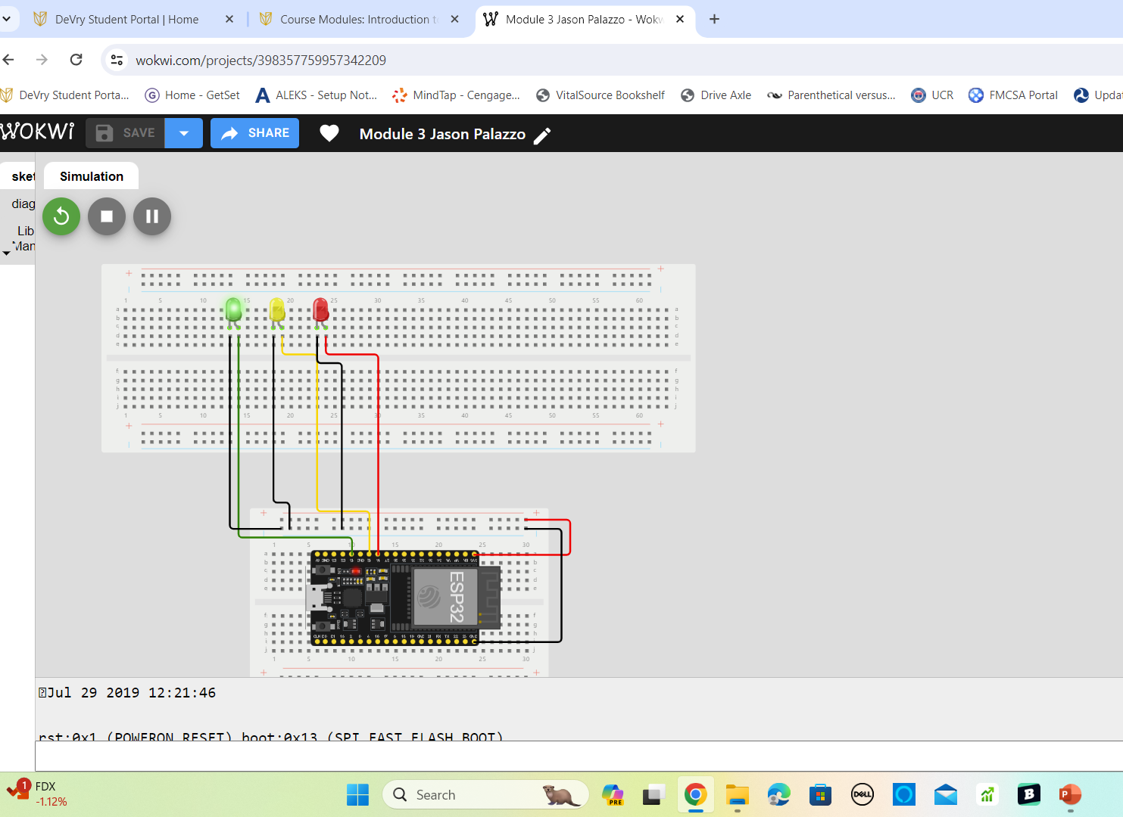
Circuit with working LEDs

Slide 8
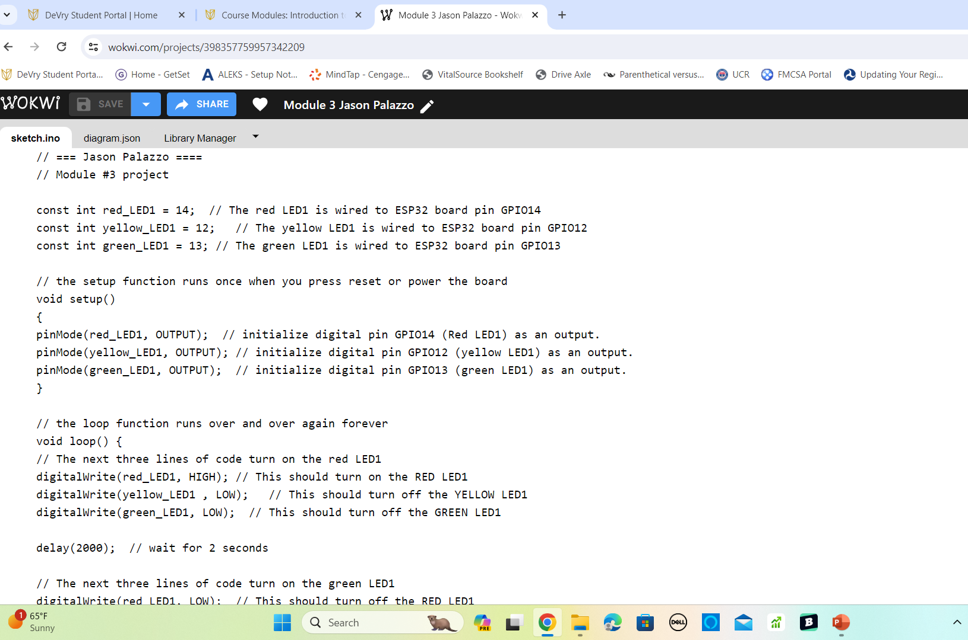
Code in the Wokwi Code Editor showing your name in the comment

Slide 9
Creating a Multiple Traffic Light Controller

Slide 10
Circuit with working LEDs

Slide 11
Code Wokwi Code Editor showing your name in the comment

Slide 12
Creating a Multiple Traffic Light Controller with a Cross Walk

Slide 13
Circuit with working LEDs

Slide 14
Code in Wokwi

Slide 15
Serial Monitor in Wokwi

Slide 16
Creating a Multiple Traffic Light Controller with a Cross Walk and an Emergency Buzzer

Slide 17
Circuit with working LEDs and LCD display

Slide 18
Code in Code Editor

Slide 19
Serial Monitor output

Slide 20
Creating a Multiple Traffic Light Controller with a Cross Walk and an Emergency Buzzer with secured IoT Control via Web

Slide 21
Circuit with working LEDs and LCD display (Building/Operation)

Slide 22
Code in Code Editor (Testing)

Slide 23
Serial Monitor (Testing)

Slide 24
Career Skills
To achieve success in your career, it's essential to comprehend the factors that drive, influence, and sustain the demand for your chosen field. This understanding provides valuable insights into the evolving electronic device market and the associated challenges and opportunities. Personally, I have honed my skills in IoT devices, specializing in the utilization of sensors, controllers, and actuators.

Slide 25
Challenges
I encountered some challenges during this journey, primarily related to the code. I required assistance as the supplied code was not working as intended. I addressed this issue by researching and learning how to write code in order to rectify the errors in the provided code.

Slide 26
Conclusion
This project gave me an excellent introduction to the world of digital devices. Understanding fundamental concepts of electronics, particularly digital electronics, operations, security, and troubleshooting is essential in this field. The course project involved building a simple, smart traffic controller. As a result, I gained a solid understanding of the hardware implementation and software development using code in Wokwi, as well as utilizing the serial monitor.

Slide 27
References
https://devryu.instructure.com/courses/109123/modules
https://www.youtube.com/watch?v=2NpRkV1qLDY

