Slide 1
Learn essential networking skills and knowledge including fundamentals, operations, security, and troubleshooting.
NETW191- Fundamentals of Information Technology and Networking
Presented by: Jason Palazzo​​

Slide 2
Introduction
Understand networking fundamentals, including network types, hardware devices, topologies, addressing, and protocols. Explain data transmission concepts and troubleshoot Wi-Fi networks. Understand network architecture and security. Segment networks and compare WAN connectivity technologies. Increase network security and implement security measures. Evaluate network operational procedures. Produce networks based on specifications. Introduced to the underlying technology of networks and the Internet. Networking basics are introduced, such as the OSI and TCP/IP models, routing protocols, switches, small network configuration, troubleshooting, and network security.

Slide 3
Implement an IPv4 addressing scheme to support a network.

Slide 4
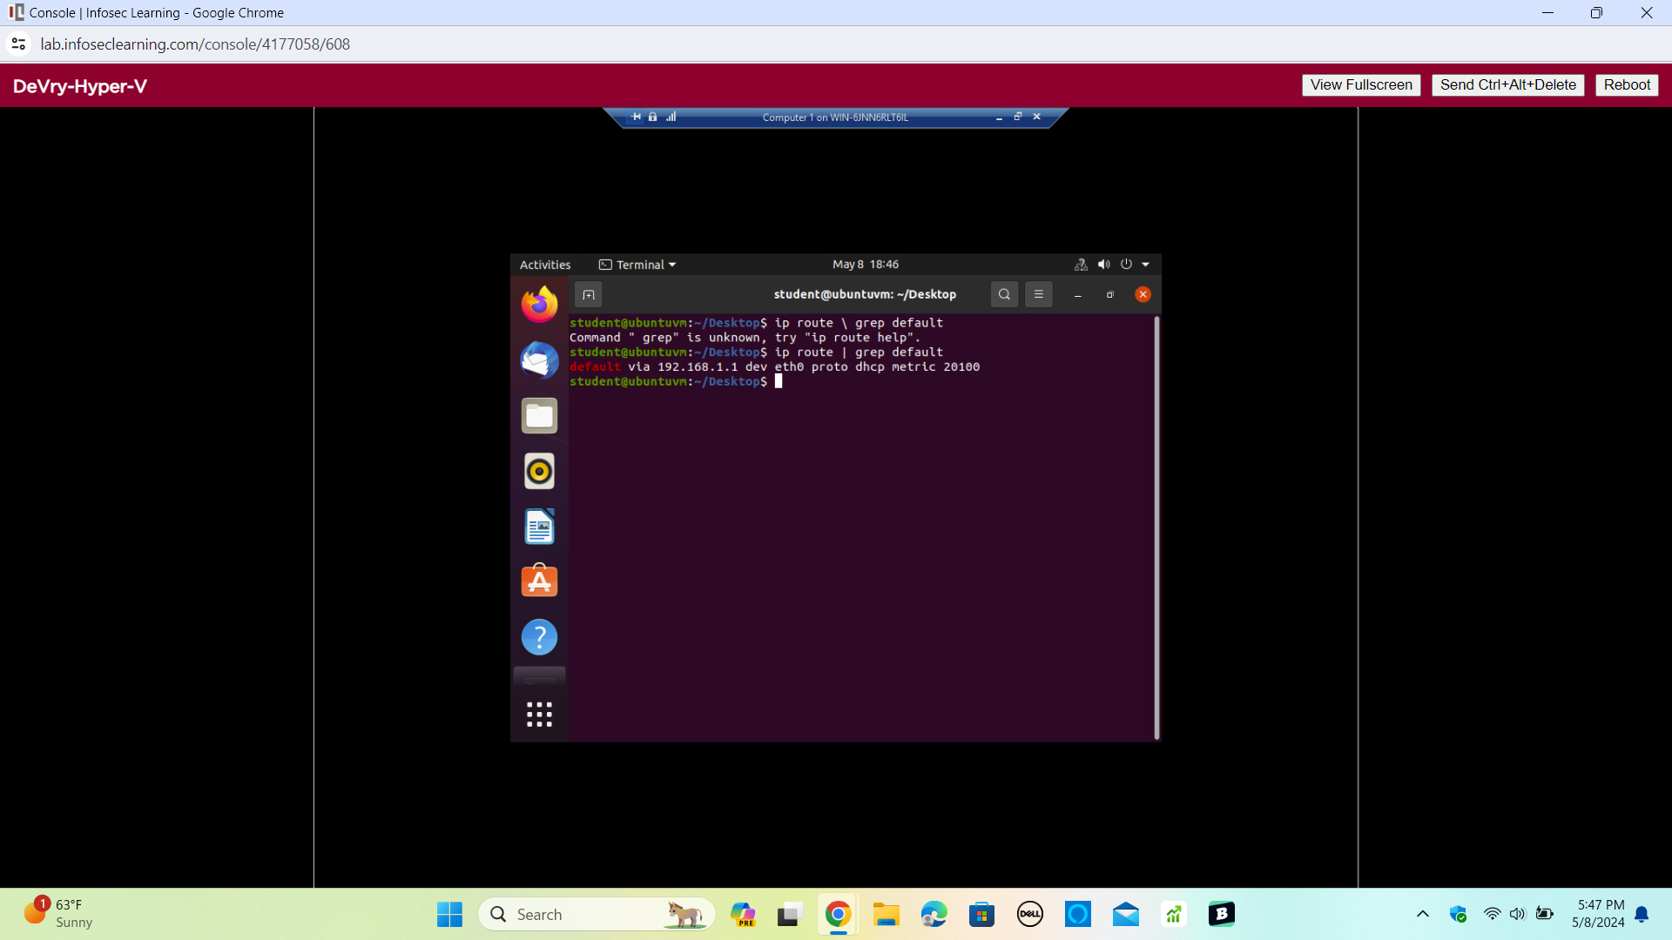
The terminal window shows the default gateway IP address.

Slide 5
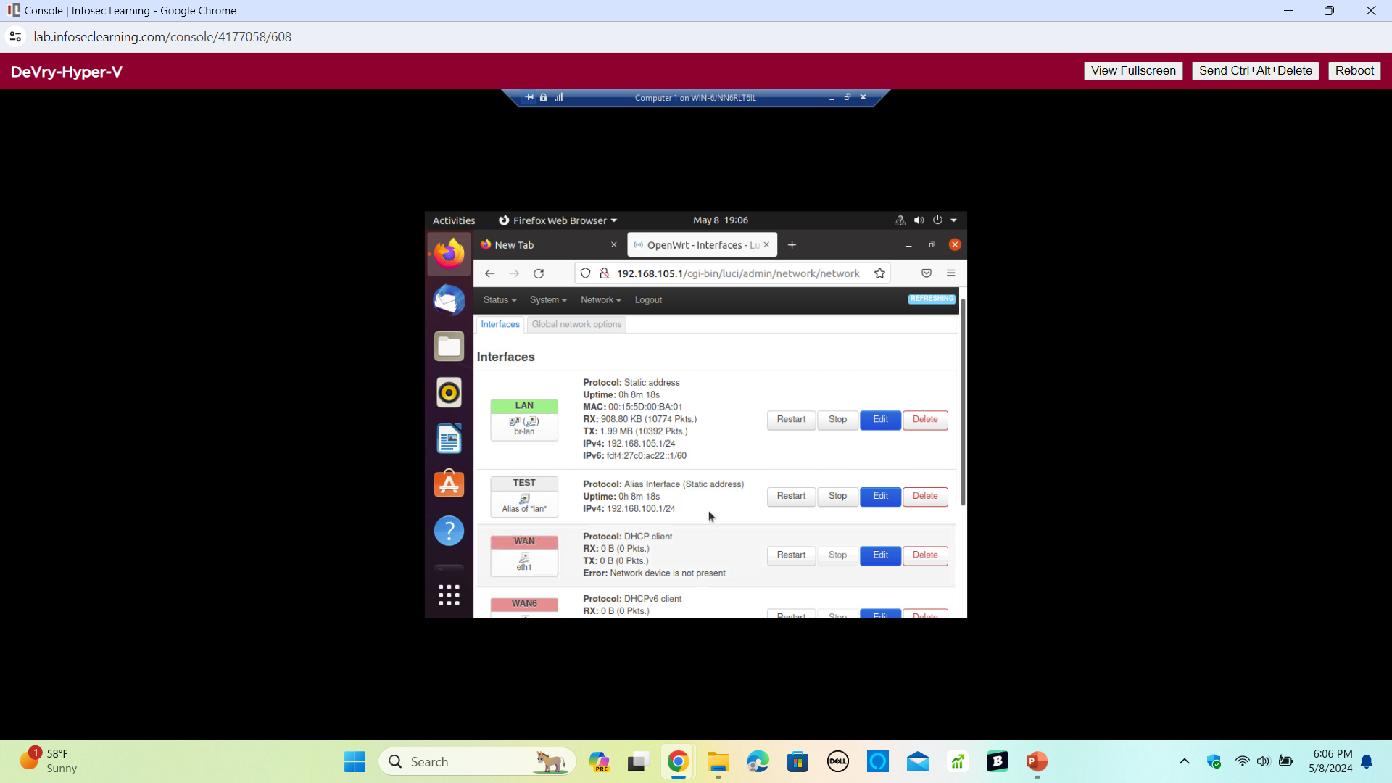
Includes the Interfaces page that shows the new IPv4 address on the LAN interface.
An IPv4 address was assigned to the SOHO Router virtual machine.

Slide 6
Tested the connectivity between two computers and the SOHO router.

Slide 7
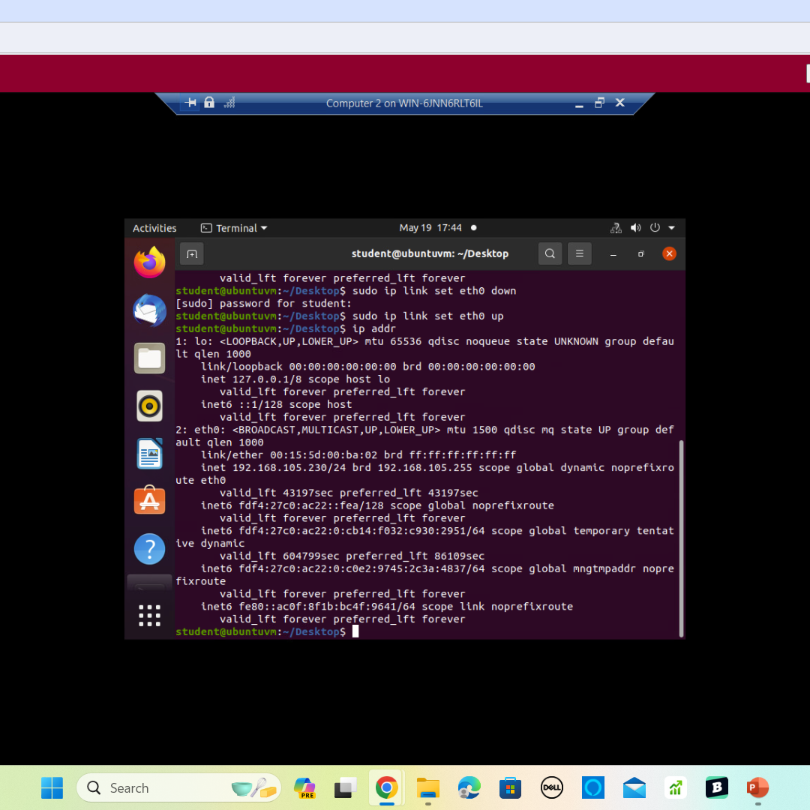
Obtain the dynamic IP address of Computer 2 VM using the "ip addr" command.

Slide 8
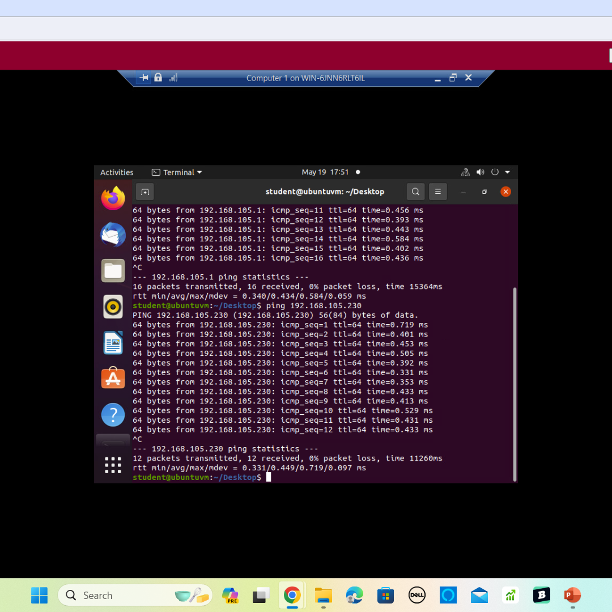
Perform a connectivity test from Computer 1 VM to the SOHO Router VM using the ping command.
Perform a connectivity test from Computer 1 VM to Computer 2 VM using the ping command.

Slide 9
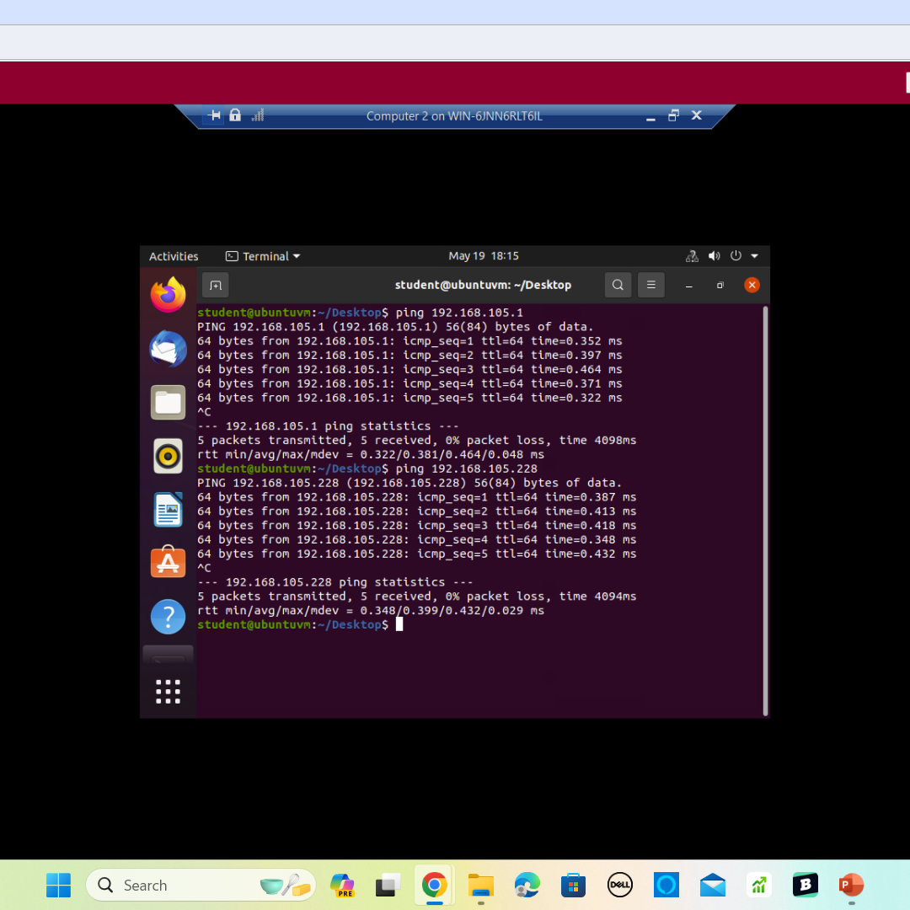
Perform a connectivity test from Computer 2 VM to the SOHO Router VM using the ping command.
Perform a connectivity test from Computer 2 VM to Computer 1 VM using the ping command.

Slide 10
IP Subnetting and Loopback Interfaces

Slide 11
Loopback Interfaces
Loopback Interfaces - A loopback interface on a router is not a physical interface like the LAN port. As a virtual interface, it is always up and available, even if other physical interfaces are down. Two loopback interfaces will be added to the SOHO Router to emulate two physical interfaces that connect to two different subnets.
Process of Performing
1.Launch the firefox browser by clicking the Firefox icon. Enter 192.168.105.1 in the browser address to
access the management interface of the SOHO Router.
2. On the Authorization Required page, enter the root password (i.e.student) and click login.
3. On the top menu bar, select Network then select interfaces to view the interfaces of the SOHO router.
4. On the bottom left corner of the screen, click on the Add New Interface button.
5. Enter Loopback1 in the Name field of the new interface. Select Static address on the
Protocol drop down menu. Select Ethernet Adapter: “eth0” (lan) on the Interface drop down
menu. Click the Create interface button to create the new interface.
6. On the Interfaces >> LOOPBACK1 page, enter 192.168.5.1 in the IPv4 address field. Click
on the IPv4 netmask dropdown menu, enter 255.255.255.128 in the bottom box, and
press the Enter key (otherwise the change will not take place). Click save. 5 pending changes click save

Slide 12
IP Subnetting
Subnet ID | Network Mask (/prefix) | Network Mask (Dotted decimal) | Network Address | First Usable Host Address | Last Usable Host Address | Broadcast Address
0 | /25 | 255.255.255.128 | 192.168.5.0 | 192.168.5.1 | 192.168.5.126 | 192.168.5.127
1 | /25 | 255.255.255.128 | 192.168.5.128 | 192.168.5.129 | 192.168.5.254 | 192.168.5.255
This table includes two /25 subnets, listing;
Subnet notation
Network address
First usable host address
Last usable host address
Broadcast address

Slide 13
Loopback Interfaces
Shows both Loopback1 and Loopback2 interfaces and their correct IPv4 addresses.

Slide 14
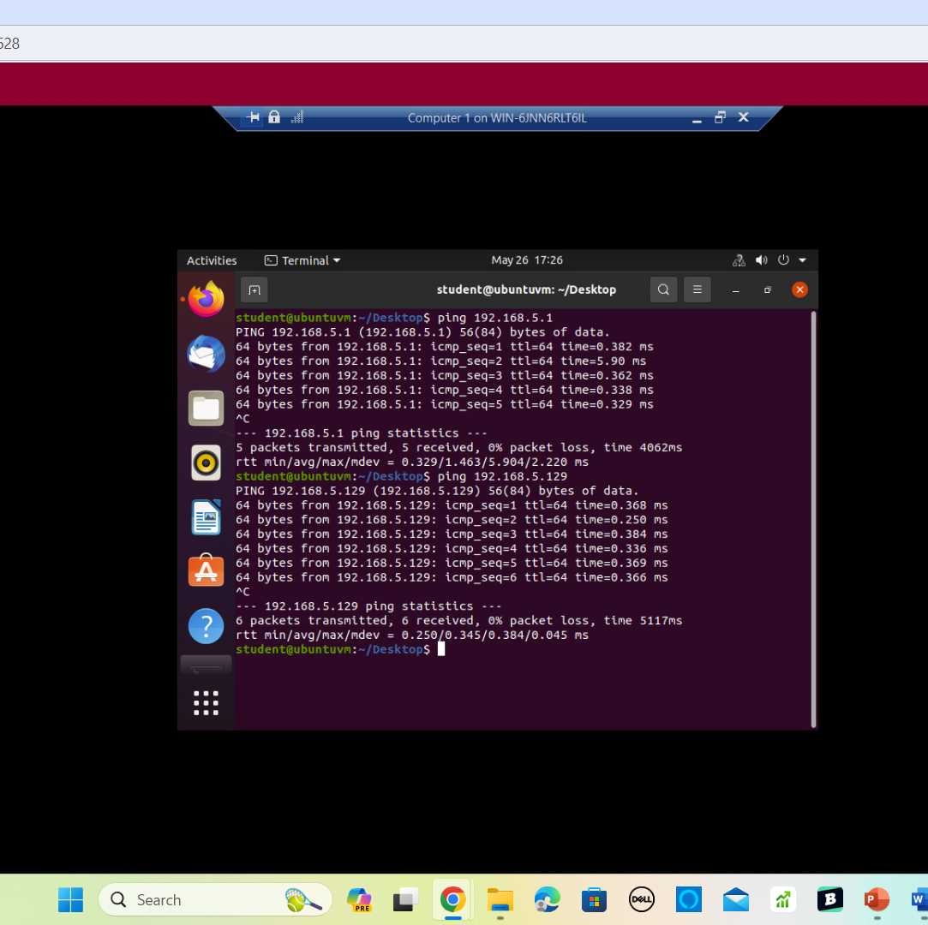
Connectivity Tests
Shows two successful ping tests:
from the Computer 1 VM to the Loopback 1 interface
from the Computer 1 VM to the Loopback 2 interface

Slide 15
Visio Network Diagram

Slide 16
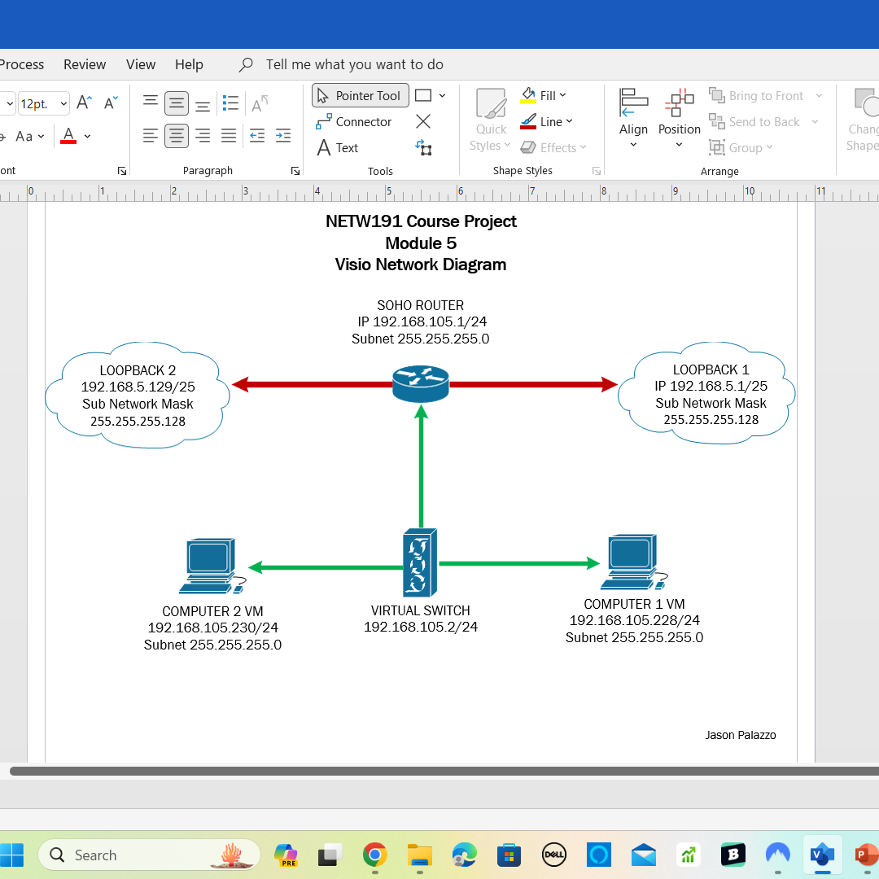
This diagram illustrates the interconnection of the Computer 1 VM, the Computer 2 VM, and the SOHO Router VM along with proper IP addresses and labeling.

Slide 17
SOHO Wireless Network Security

Slide 18
A Small Office Home Office (SOHO) LAN often uses a single network appliance to provide connectivity. Most home devices connect to the LAN wirelessly.
I explore some router configurations that could be used to add protection to a SOHO wireless network.
Open a Web browser. Visit https://www.tp-link.com/us/support/emulators to experience TP-Link product features.
Click on the TL-WR902AC model and select the revision with Hardware Version v3 and Working Mode Router.
In the left navigation pane of the router emulator, click System Tools | Factory Defaults and locate the default username and password of the router on the page.
Visit https://www.routerpasswords.com/ and find the default username and password of TP-Link routers.
Static and Dynamic IP Assignments
In the left navigation pane of the router emulator, click DHCP. Visit the DHCP Settings, DHCP Clients List, and Address Reservation pages.
MAC Filtering
In the left navigation pane of the router emulator, click Wireless 2.4 GHz | Wireless MAC Filter.
Wi-Fi Security Protocols
In the left navigation pane of the router emulator, click Wireless 2.4 GHz | Wireless Security.

Slide 19
SOHO Wireless Network Security 1 of 3
1. What are the factory default username and password of a TP-Link router? Why is it important to change the default username and password of a SOHO router?
Answer:
Its crucial to change the default username and password of a Small Office/Home Office (SOHO) router. Default credentials are widely known, which makes the router vulnerable to unauthorized access. Changing the login details enhanced security, prevents unauthorized configuration changes, protects personal data, and reduces the risk of cyber attacks.
2. To protect a SOHO wireless network with a small number of devices, which address management method provides more control, configuring the device IP addresses manually (static IP) or using a DHCP server (dynamic IP)? Why?
Answer:
A small SOHO wireless network with a limited number of devices using static IP addresses can provide more control and security, especially if the network setup rarely changes. On the other hand, utilizing a DHCP server can offer efficiency and centralized management benefits, making it easier to handle IP address assignments in a dynamic environment where devices frequently connect and disconnect from the network. Ultimately, the choice between static and dynamic IP address management methods will depend on factors such as network size, stability requirements, security considerations, and the level of control desired by the network administrator.

Slide 20
SOHO Wireless Network Security 2 of 3
3. What does MAC filtering do? If needed, when would you use deny filtering rules and when would you use allow filtering rules? What happens to devices that want to connect, if the “Allow the stations specified by any enabled entries in the list to access” function is enabled but there are no entries in the list?
Answer:
MAC filtering works by creating a list of approved MAC addresses (devices) that are allowed or denied access to the network. When a device tries to connect to the network, the router checks its MAC address against the filtering rules to determine whether to allow or deny access. When to use: Deny filtering rules, which are used when you want to specifically block certain devices from accessing your network. This could be useful for preventing unauthorized devices, such as unknown or suspicious devices, from connecting to your network. If the “Allow the stations specified by any enabled entries in the list to access” function is enabled but there are no entries in the list, the router will not allow any devices to connect to the network. This means that even if the function is enabled, without any approved MAC addresses listed, no device will be granted access to devices to connect successfully.
4. What wireless security settings are displayed on the Wireless Security page? Which one is recommended by the vendor? Why?
Answer:
WEP security, WPA/WPA2 - Enterprise authentication, and TKIP encryption are not supported with WPS enabled. For network security, it is strongly recommended that wireless security be enabled and WPA2-PSK AES encryption be selected. WPA2-PSK AES encryption for wireless security offers strong encryption, data confidentiality, robust authentication, protection against attacks, and compliance with sec

Slide 21
SOHO Wireless Network Security 3 of 3
5. Among the configurations you explored in this module, which one is a true security function? Why?
Answer:
Among the configurations we've discussed, enabling MAC filtering is a standout security function. It controls network access, prevents unauthorized access, enhances network security, and allows for customized security policies. It's a valuable security measure that can help improve the overall security of a network.
6. What would you do to protect your wireless network at home? Why?
Answer:
I would follow these key steps: 1. Use WPA@-PSK encryption with AES. 2. Change default router login credentials. 3. Enable network encryption. 4. Disable SSID broadcast. 5. Implement MAC address filtering. 6. Regularly update router firmware. 7. Use a strong WI-FI password. Implementing these measures will significantly enhance your network’s security, protecting your data and reducing the risk of unauthorized access or cyber-attacks.

Slide 22
CAREER SKILLS
Throughout this project, I had the opportunity to gain a solid understanding of IPv4 addressing, TCP/IP protocols, and network fundamentals. I learned how to address and locate software, files, computers, and other devices on a network, as well as how applications' data and instructions travel between hosts at the transport, network, and data link layers. Additionally, I gained knowledge about protocols that provide security through encryption or network access over remote connections. Furthermore, I learned how to troubleshoot common addressing and network problems using various command-line utilities. This project gave me a great basic understanding of implementing an IPv4 addressing scheme to support a network, as well as assigning an IPv4 address to the SOHO Router virtual machine. I also became familiar with correctly managing the Router Management Interface, IPv4 Address, and Virtual Machine Shutdown. This experience has brought me a step closer to my career in IoT, which is a rapidly growing industry.

Slide 23
CHALLENGES
The main technical challenge for me was a typo issue. Networking has been a challenging area for me, and I've had my fair share of difficulties. I've found the table and subnet aspects particularly challenging. However, I'm proud to share that I've made significant progress in my understanding, especially with loopback and connection tests. I encountered very few technical challenges. The only real issue I faced was understanding the project guide as it wasn’t always very descriptive.

Slide 24
Conclusion
This project provided me with an amazing introduction to the world of networking. In the world of networking; fundamentals, operations, security, and troubleshooting are essential to understand. This project gave me a great basic understanding of implementing an IPv4 addressing scheme to support a network, as well as assigning an IPv4 address to the SOHO Router virtual machine. I also became familiar with correctly managing the Router Management Interface, IPv4 Address, and Virtual Machine Shutdown. This experience has brought me a step closer to my career in IoT, which is a rapidly growing industry. , I had the opportunity to gain a solid understanding of IPv4 addressing, TCP/IP protocols, and network fundamentals. I learned how to address and locate software, files, computers, and other devices on a network, as well as how applications' data and instructions travel between hosts at the transport, network, and data link layers.

Slide 25
References
Piscitello , D., & Chapin, .. L. (1993). OPEN SYSTEMS NETWORKING TCP/IP AND OSI
(1st ed., p. 603). Addison-Wesley Publishing Company. https://www.interisle-group.com/OSN/OpenSysNet.pdf
Devry University (n.d.). Module 2: Lesson 2 - TCP/IP Protocols.
Https://Devryu.Instructure.com/Courses/109762/Assignments/3406267?Module_item_id=14049147.
Retrieved May 11, 2024, from https://devryu.instructure.com/courses/109762/assignments/3406267?module_item_id=14049147
https://lab.infoseclearning.com/course/NMMQQFKYZF/lab/GUBMSVYPGQ?check_logged_in=1
https://www.youtube.com/watch?v=IzLc5UPUPF0
https://www.youtube.com/watch?v=PyducJ6n3Ps
https://devryu.instructure.com/courses/109762/assignments/3406389?module_item_id=14049298
https://emulator.tp-link.com/902AC_US_Emulator/Emulator_Router/index.htm
https://www.routerpasswords.com/tp-link-default-router-password/

Slide 26
Thank you
Jason Palazzo
www.jasonpalazzo.com​

